Slide 1
Consumer Behavior in the Nigerian Auto Market
By: Matthew Bennett

Slide 2
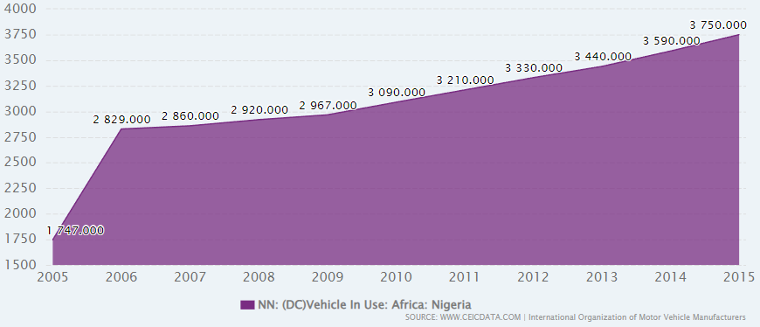
Background
Between 2003 and 2013, the size of the population increased by more than 40m people…the real growth is yet to come: by 2050, Nigeria will number more than 440m people” (M2PressWire, 2014).
Nigerian consumers value fuel efficiency, and this can be seen when gas prices soared in 2012.
The number of registered vehicles in Nigeria continues to grow since 2006
The Nigerian car prices data set contains transaction information for cars sold online in Nigeria
Notes:
Nigeria is the largest country in Africa, both by the size of its economy and the size of its population. Between 2003 and 2013, the size of the population increased by more than 40m people…the real growth is yet to come: by 2050, Nigeria will number more than 440m people.
According to the figure below, the number of registered vehicles doubled between 2005 and 2006. It continues to increase beyond 2006
“Nigerian motorists and unions vented their anger on Monday at skyrocketing fuel prices, which more than doubled a day after government subsidies were lifted in a sweeping economic reform. Opposition leaders and unionists condemned the move by the state's fuel regulator, which they say will push up prices at a time when many Nigerians, most of whom live on less than $2 per day, already find fuel too expensive” (Reuters, 2012).
The Nigerian car prices data set reflects the current auto market in the country. This data set was sourced from a little less than four thousand entries pulled from online sales

Slide 3
Objectives
Nigeria is expecting a continuous rise in population and registered vehicles
This creates demand for more affordable vehicles in Nigeria
Retailers, buyers, and manufacturers will benefit from the results of this study
The purpose is to identify vehicle attributes that people in Nigeria often value
Findings from this project will provide insights on which vehicle attributes are important in the market.
Notes:
Nigeria is expecting its population to continuously rise until at least 2050.
The number of registered vehicles also continues to rise.
An increase in population and registered vehicles means an increase in demand in the Nigerian auto market.
This creates opportunities for buyers, retailers, and manufacturers to learn more about the market and capitalize on the newly realized demand.
The purpose of this project is to identify vehicle attributes that the Nigerian auto market tends to value.
Findings from this project should inform the buyers, retailers, and manufacturers on what auto consumers tend to value.

Slide 4
Research Questions and Hypotheses
Hypothesis 1: There is a positive correlation between a certain car make and sales volume
H_{o}: There are no correlations between car make and sales volume
H_{a}: There are no positive correlations between car make and sales volume
Hypothesis 2: There is a positive correlation between a certain car type and sales volume
H_{o}: There are no correlations between car type and sales volume
H_{a}: There are no positive correlations between car type and sales volume
Hypothesis 3: There is a positive correlation between a certain drivetrain and sales volume
H_{o}: There are no correlations between drivetrain and sales volume
H_{a}: There are no positive correlations between drivetrain and sales volume
Hypothesis 4: There is a positive correlation between a horsepower and vehicle price
H_{o}: There is no correlation between horsepower and vehicle price
H_{a}: There is a negative correlation between horsepower and vehicle price
Notes:
Hypothesis 1: There is a positive correlation between a certain car make and sales volume
H_{o}: There are no correlations between car make and sales volume
H_{a}: There are no positive correlations between car make and sales volume
Hypothesis 2: There is a positive correlation between a certain car type and sales volume
H_{o}: There are no correlations between car type and sales volume
H_{a}: There are no positive correlations between car type and sales volume
Hypothesis 3: There is a positive correlation between a certain drivetrain and sales volume
H_{o}: There are no correlations between drivetrain and sales volume
H_{a}: There are no positive correlations between drivetrain and sales volume
Hypothesis 4: There is a positive correlation between a horsepower and vehicle price
H_{o}: There is no correlation between horsepower and vehicle price
H_{a}: There is a negative correlation between horsepower and vehicle price

Slide 5
Literature Review
In 2026, the Nigerian new cars market is forecast to have a value of $0.5 billion, an increase of 66.7% since 2021” (MarketLine, 2022).
According to the CEIC, the amount of registered vehicle owners in Nigeria almost doubled between 2005-2006 hitting 2.8 million vehicles.
“By 2050, Nigeria is a country of low-carbon, climate-resilient, highgrowth circular economy that reduces its current level of emissions by 50%, moving towards having net-zero emissions across all sectors of its development in a gender-responsive manner” (Dept. of Climate Change, Federal Ministry of Environment, Nigeria, 2021).
The Nigerian government has also established an initiative to produce more local vehicles with an emphasis on electric cars to further suppress their footprint by 2050.
Notes:
By 2026, the Nigerian new cars market is expected to increase by 66.7% with a value of $0.5 billion
Also, according to the CEIC, the amount of registered vehicle owners in Nigeria almost doubled between 2005-2006 hitting 2.8 million vehicles.
In addition, Nigeria’s Federal Ministry of Environment and Dept. of Climate Change had this to say about their plans regarding emissions
“By 2050, Nigeria is a country of low-carbon, climate-resilient, highgrowth circular economy that reduces its current level of emissions by 50%, moving towards having net-zero emissions across all sectors of its development in a gender-responsive manner”
The Nigerian government has also established an initiative to produce more local vehicles with an emphasis on electric cars to further suppress their footprint by 2050.
All of this supports a potential boom in the Nigerian auto market as the government subsidizes locally manufactured vehicles with an emphasis on electric cars. The auto market can use the findings from this project to inform buying, selling, and manufacturing decisions

Slide 6
Research Design
Statistical testing completed in SAS Studio, while Tableau was used for presenting findings
The first three hypotheses were tested using distribution tests, while the fourth and last was tested using a regression model
The first three hypotheses will be tested against sales volume to find an accurate distribution of vehicle transactions
The final hypothesis will be tested with horsepower as the continuous variable and vehicle price as the dependent
The final hypothesis can be confirmed with an alpha less than 0.05 at a confidence interval of 95%
Notes:
Statistical testing completed in SAS Studio, while Tableau was used for presenting findings
The first three hypotheses were tested using distribution tests, while the fourth and last was tested using a regression model
The first three hypotheses will be tested against sales volume to find an accurate distribution of vehicle transactions
The final hypothesis will be tested with horsepower as the continuous variable and vehicle price as the dependent
The final hypothesis can be confirmed with an alpha less than 0.05 at a confidence interval of 95%. In addition, a trend line will be used to help visualize any apparent trends.

Slide 7
Limitations
Initially, this project planned to test all relevant variables.
  Fourth and final hypothesis was created from this exercise
This project cannot provide enough information to show a clear view of the Nigerian auto market
  This is due to lack of resources and time
Lastly, Tableau was expected to cause some roadblocks.
These limitations did not have an effect on the credibility of this project’s findings
Notes:
Initially, this project planned to test all relevant variables, but this ambitious goal was not met.
However, the fourth and final hypothesis was created from this exercise
This project cannot provide enough information to show a clear view of the Nigerian auto market
This is due to lack of resources and time
Lastly, Tableau was expected to cause some roadblocks due to the author’s lack of experience with the program
These limitations did not have an effect on the credibility of this project’s findings

Slide 8
Ethical Considerations
It’s important that this project empowers consumers more than retailers.
The purpose of this project is to empower consumers with the knowledge of the Nigerian auto market
  Auto retailers do not need additional leverage in the market
Inform local manufacturers on how they can produce a vehicle tailored to the culture
Failing to comply with these expectations is not necessarily unethical.
Notes:
It’s important that this project empowers consumers more than retailers.
The purpose of this project is to empower consumers with the knowledge of the Nigerian auto market
Auto retailers do not need additional leverage in the market
Additionally, it can be used to inform local manufacturers on how they can produce a vehicle tailored to the culture
Failing to comply with these expectations is not necessarily unethical, but failure does mean that the purpose has not been fully met.

Slide 9
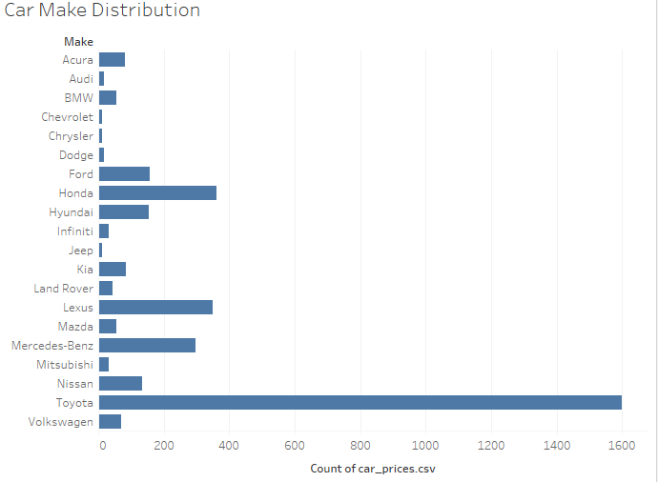
Findings Car Make
Toyota, Hyundai, Honda; A market for affordable import vehicles
BMW, Lexus, Mercedes Benz: A smaller market for luxury import vehicles
Toyota satisfies and confirms the first hypothesis
There is a positive correlation between a certain car make (Toyota) and sales volume
Notes:
Toyota, Hyundai, Honda; A market for affordable import vehicles
BMW, Lexus, Mercedes Benz: A smaller market for luxury import vehicles
Toyota satisfies and confirms the first hypothesis
There is a positive correlation between a certain car make (Toyota) and sales volume

Slide 10
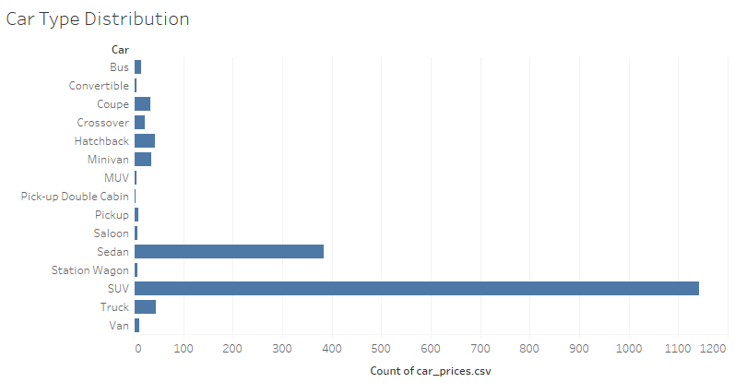
Findings Car Type
SUVs and Sedans were by far the most popular car types
SUVs are most popular with Sedan at a distant second
Second hypothesis can be confirmed with a positive correlation between a certain car type (SUV) and sales volume
Notes:
SUVs and Sedans were by far the most popular car types
SUVs are most popular with Sedan at a distant second
Second hypothesis can be confirmed with a positive correlation between a certain car type (SUV) and sales volume

Slide 11
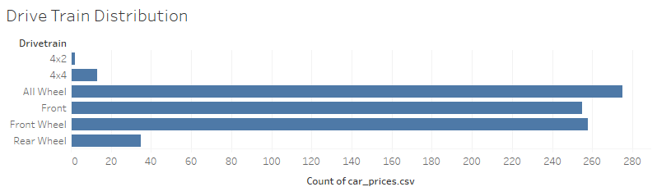
Findings Drive Train
All Wheel, Front, and Front Wheel drive trains seem to be equally as popular
All Wheel sits in first by a decent amount of sales
However, there does not seem to be a correlation between a certain drive train and sales volume
The null hypothesis is accepted
SUVs are valued more for their fuel efficiency and seating rather than drivetrain
Notes:
All Wheel, Front, and Front Wheel drive trains seem to be equally as popular
All Wheel sits in first by a decent amount of sales
However, there does not seem to be a correlation between a certain drive train and sales volume
The null hypothesis is accepted
SUVs are valued more for their fuel efficiency and seating rather than drivetrain

Slide 12
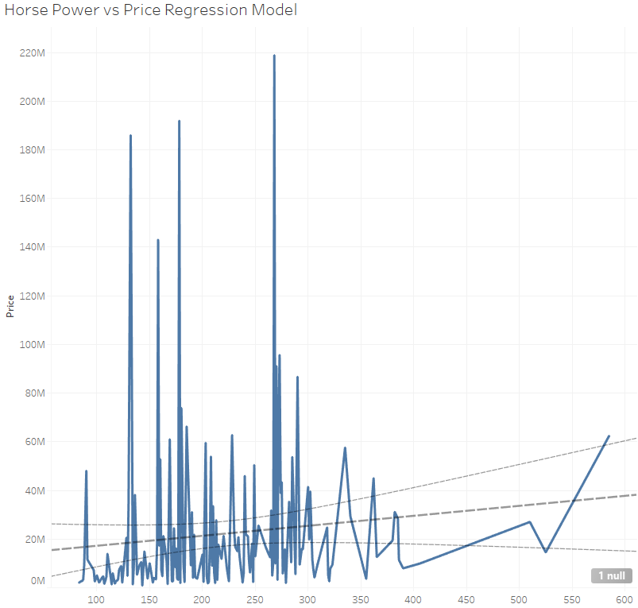
Findings Horsepower vs. Price Regression Model
Horsepower had an alpha of under 0.05 as a predictor for price at confidence interval of 95%
The trend line suggests a positive correlation between horsepower and vehicle price
The fourth hypothesis can be accepted with a positive correlation between horsepower and vehicle price
Notes:
Horsepower had an alpha of under 0.05 as a predictor for price at confidence interval of 95%
The trend line suggests a positive correlation between horsepower and vehicle price
The fourth hypothesis can be accepted with a positive correlation between horsepower and vehicle price

Slide 13
Conclusion
Overall, the Nigerian auto market values affordable, durable, and spacious vehicles.
According to this study, most Nigerian consumers should be buying a Toyota SUV at a lower horsepower
The results of this project should be able to inform buyers, retailers, and manufacturers
Manufacturers can use this project to inform their design process to ensure their vehicles coincide with local needs
Retailers can use this project to help consumers find a vehicle they want and can afford
Buyers can use this project to inform their own consumer behavior to ensure less buyer’s remorse
Notes:
Overall, the Nigerian auto market values affordable, durable, and spacious vehicles.
According to this study, most Nigerian consumers should be buying a Toyota SUV at a lower horsepower
The results of this project should be able to inform buyers, retailers, and manufacturers on consumer values in the Nigerian auto market
Manufacturers can use this project to inform their design process to ensure their vehicles coincide with local needs
Retailers can use this project to help consumers find a vehicle they want and can afford
Buyers can use this project to inform their own consumer behavior to ensure less buyer’s remorse

Slide 14
References
Busse, M. R., Lacetera, N., Pope, D. G., Silva-Risso, J., & Sydnor, J. R. (2013). Estimating the Effect of Salience in Wholesale and Retail Car Markets. The American Economic Review, 103(3), 575–579.
Campbell, Lord. (1968). Journal of Retailing, 44(1), 54.
CEIC. (2015). Nigeria Registered Motor Vehicles. Nigeria Registered Motor Vehicles, 2005 – 2022 | CEIC Data. Retrieved November 16, 2022, from https://www.ceicdata.com/en/indicator/nigeria/motor-vehicle-registered
Department of Climate Change, Federal Ministry of Environment, Nigeria. (2021). United Nations Framework Convention on Climate Change. 2050 Long-Term Vision for Nigeria (LTV-2050). Retrieved November 27, 2022, from https://unfccc.int/sites/default/files/resource/Nigeria_LTS1.pdf
Emerging Consumer Lifestyles in Nigeria. (2014). M2PressWIRE.
Malhotra, K., & Kavita. (2022). Consumer Buying Behavior and Brand Choice in Sport Utility Vehicle (SUV) Segment: A Literature Review. IUP Journal of Brand Management, 19(1), 40–52.
MarketLine Industry Profile: New Cars in Nigeria. (2022). New Cars Industry Profile: Nigeria, 1–44.
O'Leary, Z. (2021). The Essential Guide to doing your research project. SAGE.
Olurounbi, R. (2022). Nigeria Inflation Exceeds Expectations on Cereals, Gas Prices. Bloomberg.Com, 1.
Reuters News Agency. (n.d.). Nigerians fume at fuel price hike. Toronto Star (Canada).

